Slide 1
Creating a 3D Protein visualization function
Manasveni Kilnagar Swaminathan
S2852489
University of Groningen

Slide 2
An introduction
Proteins are key biological macromolecules. The functions of a protein depends on its structure.
There are various databases that provide macromolecular structure data of proteins, such as the RCSB PDB (Protein Data Bank).
A PDB file format contains lots of information about the protein such as nature of molecule, experimental studies, amino acid residues, helical structures, heterogens and most importantly, the atomic coordinates of the molecule.

Slide 3
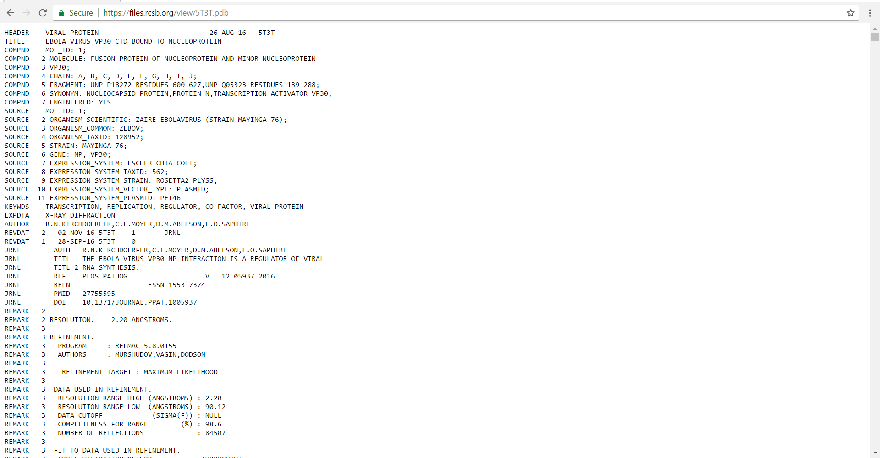

Slide 4
Aim and Objective
The aim of my project is to create functions using python and shell scripting language that will :
1. Download pdb files from the database and store to drive.
2. Parse out the atomic coordinate information from a PDB file.
3. Display the protein on a three-dimensional axis.
4. Display amino acid and occurrences in the protein.

Slide 5
WORKFLOW
Shell function
Python function

Slide 6
Shell function
A shell function was created using a bash script: “script1.sh”
The function :
Retrieves the respective pdb file from the internet using the protein code provided by the user and downloads the file under filename (userinputcode.pdb)
“cUrl --remotename ” command
2. Searches the file for numerical position data of amino acids using grep, counts the number of times the amino acids occur and displays to user

Slide 7
URL format for pdb file: https://files.rcsb.org/view/(variable).pdb
ATOM... 9 HA LEU A 347 34.823 -35.400 -13.896 1.00550.00 H
ATOM... 10 HB2 LEU A 347 33.572 -33.207 -12.654 1.00550.00 H

Slide 8
script1.sh
#!/bin/bash
echo "Enter proteincode and press [ENTER]:"
#to obtain user input
read proteincode
$proteincode= proteincode
#to assign a variable to user input
curl --remote-name https://files.rcsb.org/view/$proteincode.pdb
#curl function with remote name for downloading any .pdb code file (defined by variable) from the website
grep ATOM $proteincode.pdb | grep -v REMARK | cut -c 18-21,24-26 | sort | uniq | cut -f 1 -d " " | uniq -c | sort -nr
#to display amino acid occurrence in the protein on the interface

Slide 9
An example output :
The function will ask the user for a protein code
The user must enter the pdb id of any protein he wants to analyse or visualise .
Example : “4ZRY” (Crystal structure of human intermediate filament proteins keratin 1 (KRT1) and keratin 10 (KRT10))
The function runs and the user is provided with information such as types of amino acids and their occurrences in the protein.

Slide 10
32 LEU
27 GLU
23 GLN
18 ILE
16 SER
15 ARG
15 ALA
13 ASN
11 LYS
11 ASP
10 THR
6 TYR
5 VAL
5 GLY
2 CYS
1 MET
1 HIS
A pdb file is automatically stored in the current working directory as 4ZRY.pdb

Slide 11
Python function
A python function was created using python script : script2.py
The function :
1.Searches for atomic coordinate data from inputted pdb files (downloaded by running shell function).
Atomic coordinates are located in lines beginning with ATOM.
Using conditional statement ‘if’
2. Splits the data into space-limited strings line.split()
3. Plots the coordinate using tool pyplot from package matplotlib

Slide 12
script2.py
#!/usr/bin/env python
myprotein = [] #assign an empty list to store extracted values of x,y,z
proteinseq = "4ZRY.pdb” #input
proteinseq = raw_input("enter file name: ")
# multiple inputs by user from files downloaded using shell script
#condition to search for atomic coordinates in columns of ATOM data
with open(proteinseq) as protein:
for lines in protein:
if "ATOM " in lines:
lines = lines.split() #to split the lines of ATOM into lines separated by white space
myprotein.append(map(float, lines[6:9]))
#append() function combines the coordinate data from 3 columns and assigns to list myprotein #float() converts all non-float values to float #map
import matplotlib.pyplot as plt #pyplot is a 2D/3D plotting tool

Slide 13
mpl_toolkits.mplot3d import Axes3D #axes3d creates a 3D axes
x,y,z = zip(*myprotein)
#zip function when used with * used to separate lists of equal lengths into individual lists
#here coordinate data will get assigned to respective lists
fig = plt.figure()
ax = Axes3D(fig)
ax.plot(x,y,z, "o")
#o is a default marker
plt.show()
#to show the plot

Slide 14
Matplotlib
Plotting library in python
Creates 2D (line, scatter, histogram)and 3D (surface, quiver, contour)plots
I used module “pyplot” (python with matlab interface)
I used tool Axes.3D to obtain 2d projections of the 3d structure
For this function I am only plotting the protein and obtaining output as .png image.

Slide 15
An example Output
Consider the previously downloaded pdb file “4ZRY.pdb”
When the user enters the file name in the input command, and the function is run the following image will be displayed.
The image is interactive at the terminal and allows the user to perform basic mouse functions like rotate, zoom, pan . The user can view the tertiary structure of the protein and learn its alignment, position of coordinates.

Slide 16
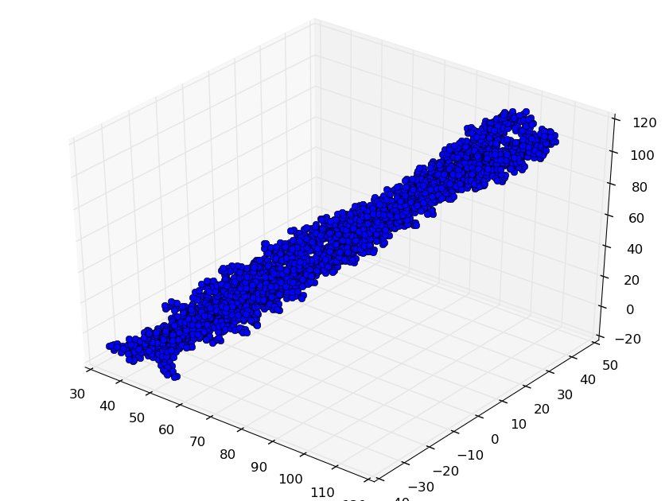
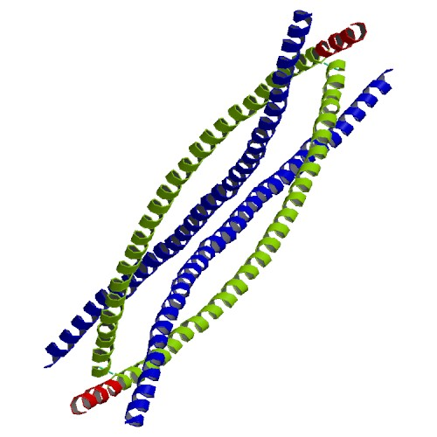
(Source: RCSB PDB)

Slide 17
Discussion and scope for future work
In my project, I have created two functions in shell and python programming environment that allows users to understand the tertiary structure and obtain basic information about the protein such types of amino acid present and their occurrences.
-working with np arrays and numpy
-obtaining gifs
-More information on quaternary structures
-sequence alignment using biopython

Slide 18
Thank you !

